Slide 1
Network security
Supervisor: Shoubra Faculty of Engineering-Benha University
Dr: Heba Adly

Slide 2
Team members
Mohmmed Abdelrazak Mohammed Ali
Taha Farid Taha Abdallh
Mohammed Ali Mohammed Rizk
Kerelos Amin Thabet Amin
Ezzat Gamil Ezzat Abdelbaset
Kirolos Romany Samir Habeab

Slide 3
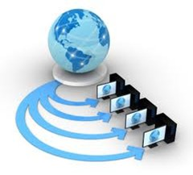

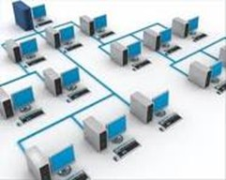
Introduction

Slide 4



introduction
Our project is planning and implementing a production network from scratch is a complex, time-consuming process in which many divisions of the organization are involved, including not only IT professionals. Everything should be taken into account from the geographical location of the planned construction to the analysis of specific websites that a potential employee can visit during the working day.
To complete this task, we have studied the principles of building networks, possible topologies and the construction of a three-level hierarchical network design model.
Main required training courses: CCNA,CCNP-SCORE, and SNCF.

Slide 5
start
Required tools
Build the network
network configuration
Test
Common attacks
Infrastructure protection
Access the servers
Build the servers
Connect the internet
Firewall
Test

Slide 6
Required tools

Slide 7
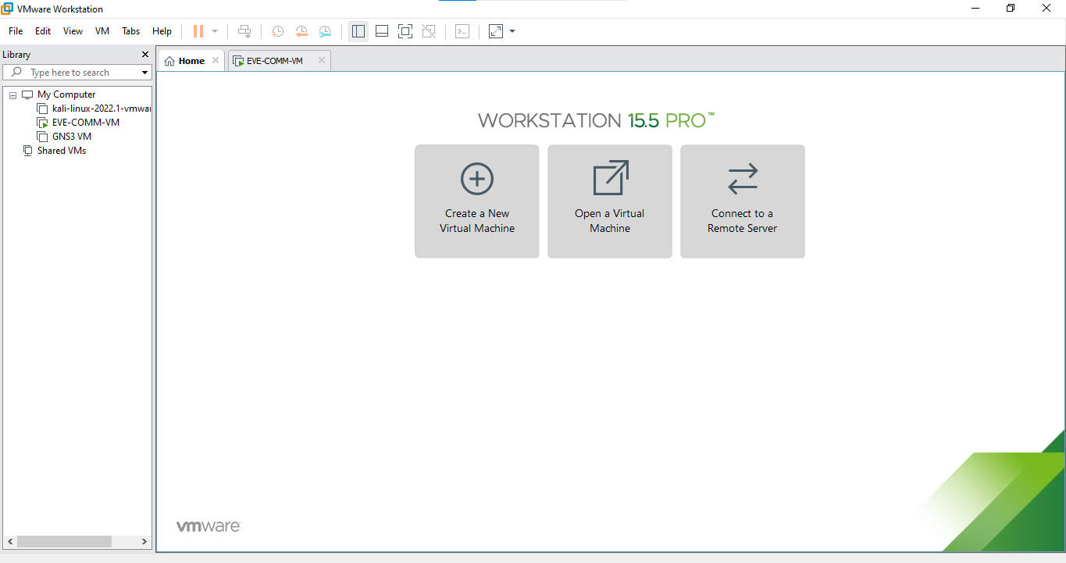

VMware
EVE-NG machine

Slide 8
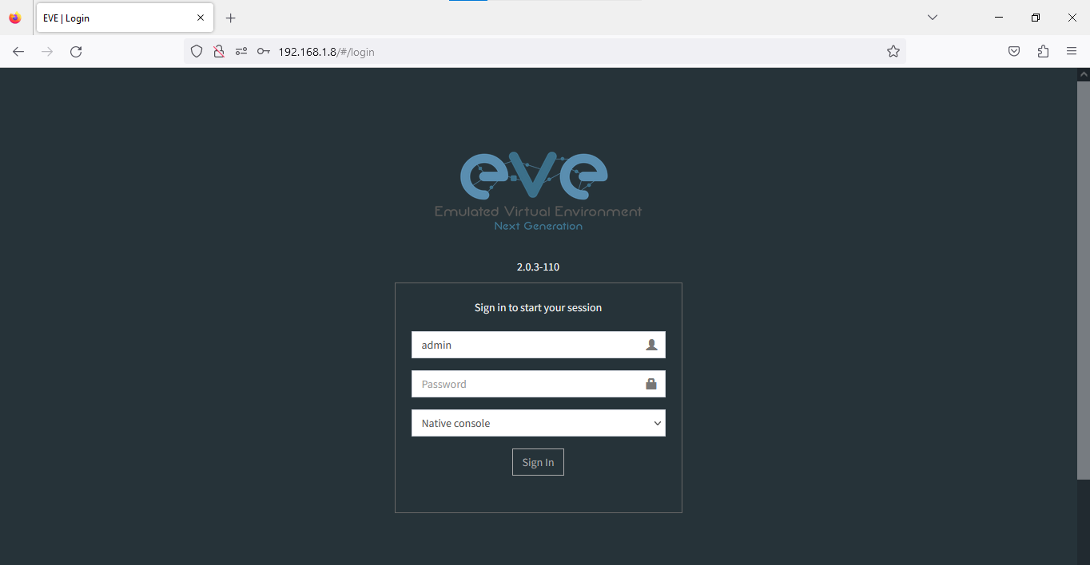
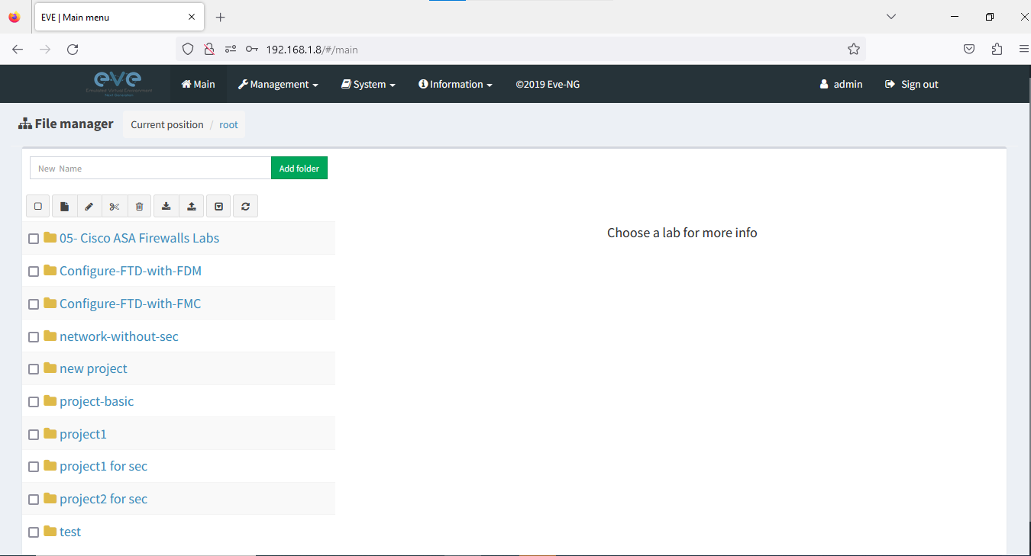
Access EVE from the browser

Slide 9
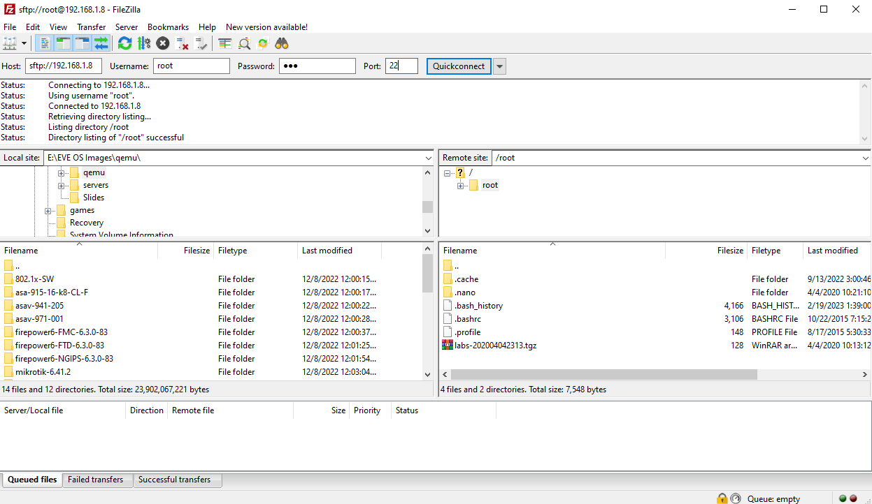
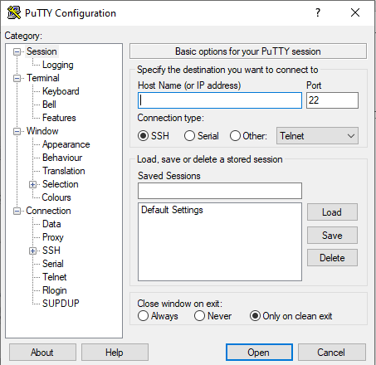
FileZilla Server is a free open source FTP and FTPS Server.
PuTTY is an SSH and telnet client.

Slide 10
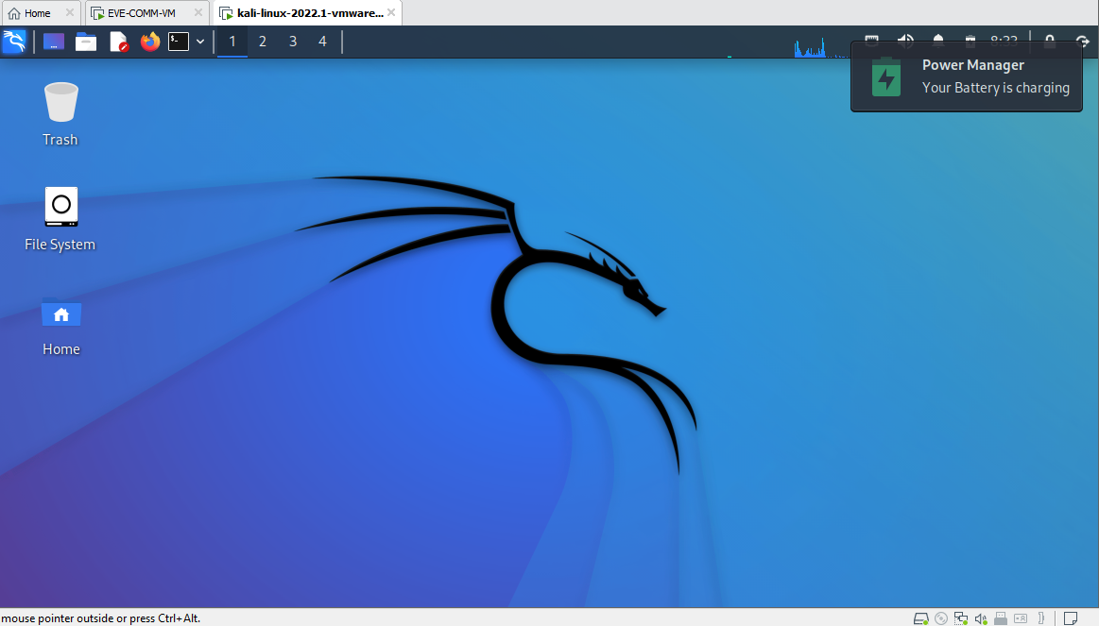
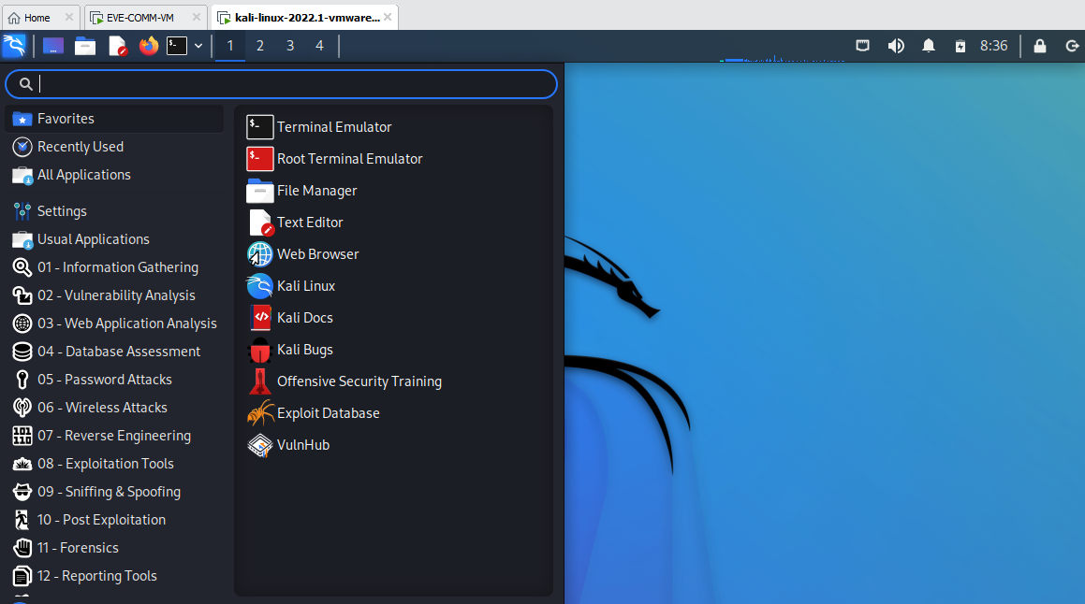
kali-linux-2019.3-vmware:

Slide 11

Building the network

Slide 12

MANG
DHCP
server
FTP
server
FW
FW
internet
CORE
DMZ
R3
R2
HR-MANG (SW)
CS-SALE (SW)
IT (SW)
ACCO-PROD (SW)

Slide 13
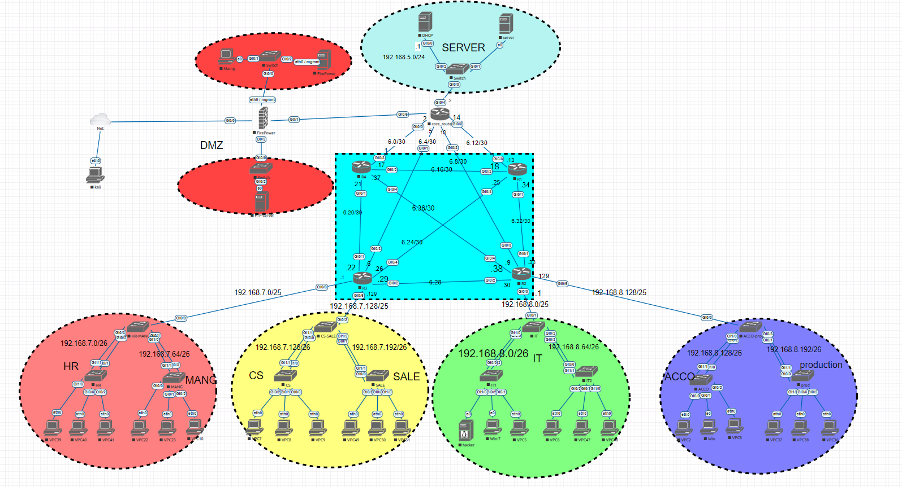

Slide 14
Common TCP-IP Attacks

Slide 15
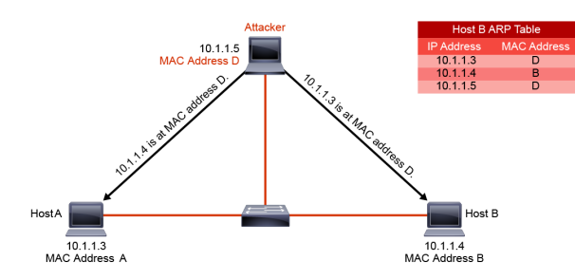
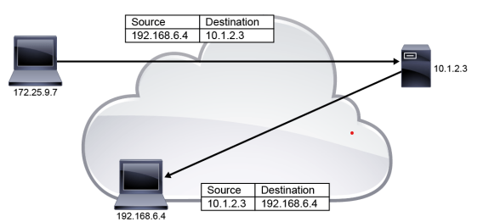
IP Vulnerabilities
Man-in-the-middle attack (MITM):
IP address spoofing:

Slide 16
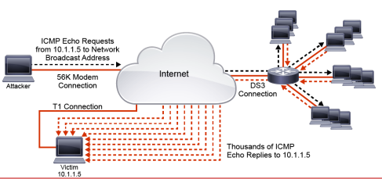
IP Vulnerabilities (cont.)
DoS attack: In a DoS attack, an attacker attempts to prevent legitimate users from accessing information or services.
DDoS attack: A DDoS attack is a DoS attack that features a simultaneous, coordinated attack from multiple source machines.

Slide 17
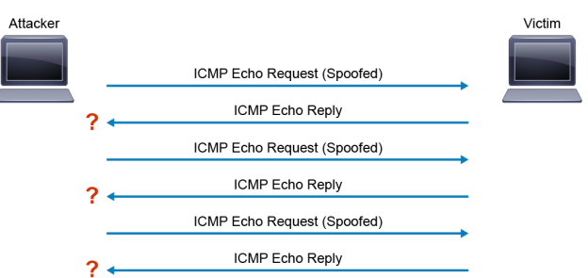
ICMP Vulnerabilities
ICMP datagrams are often associated with commands that are used by network administrators, such as ping and traceroute.
ICMP can be used to launch information gathering attacks. Attackers can use different methods within the ICMP to find out live host, network topology, and OS fingerprinting
ICMP flood attack:

Slide 18
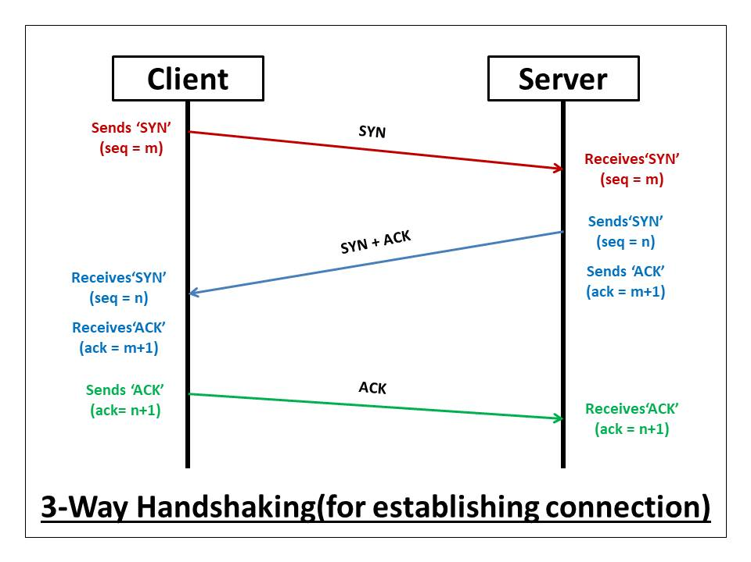
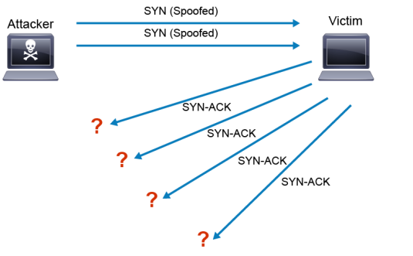
TCP Vulnerabilities
TCP SYN flooding

Slide 19
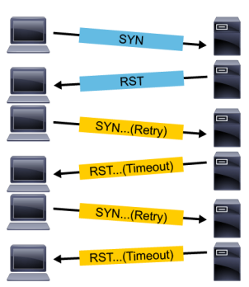
TCP Vulnerabilities(cont.)
TCP Reset Attack

Slide 20
Network Infrastructure Protection

Slide 21
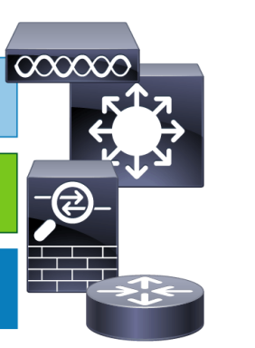















Identifying Network Device Planes
Data Plane functions are data switching and data routing. The data plane allows the device to forward network traffic and apply services (such as security, and QoS.) to it.
Control Plane allows the device to build all the required control structures (such as the routing table, forwarding table, and MAC address table) that will allow the data plane to operate correctly.
Management Plane provides devices with all of the functions that administrators need to provision the configuration and monitor the operation of the device.

Slide 22
Routing

Slide 23
Routing is a process of selecting path along which the data can be transferred from source to the destination. Routing is performed by a special device known as a router.
Forming routing tables using routing protocols(RIP,ospf,etc…) ,and forwarding by compare destination IP in routing table is the process of routing.
Routing is 2 types:
Routing
static
dynamic

Slide 24
Static Routing
routes through a network are described by fixed paths.
A change, such as the loss of a node, or loss of a connection between nodes, is not compensated until the admin reconfigure static routing manually again.
Static routing is used to configure default route.
Command format:
R2 core router:
Ip route (network name) (subnet mask) (next hop)
Ip route 0.0.0.0 0.0.0.0 0.0.0.0 192.168.6.10

Slide 25
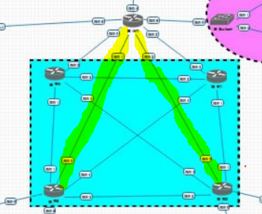
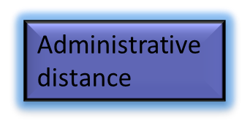


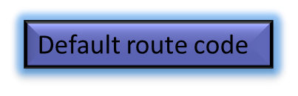



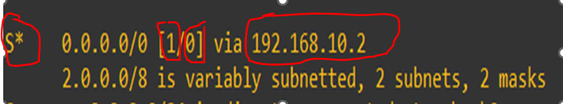
Default routes

Slide 26
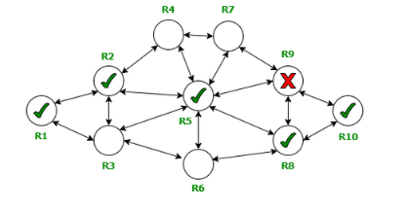
Dynamic Routing
Dynamic routing : a technique of finding the best path for the data to travel over a network, it enables routers to select paths according to real-time logical network layout changes.
The most popular dynamic routing protocols are (RIP,OSPF….)
Why dynamic routing?
Advantages of dynamic routing
Allows the exchange of routing information whenever the network experiences a change in topology.
Since the routes do not have to be configured manually, there is less administrative overhead and Less error-prone than static routing.
Allows scalability since there is less administrative overhead involved.

Slide 27
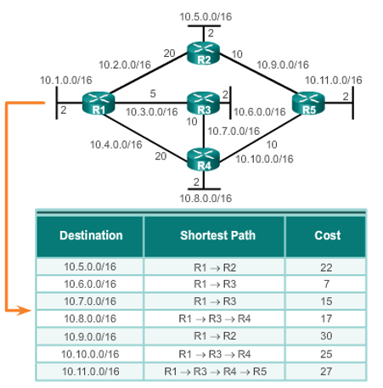
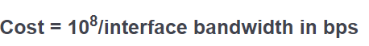
Open short path first(OSPF)
OSPF characteristics:
interior gateway protocol that has been designed within a single autonomous system.
based on a link-state routing algorithm(every router has a detailed map about the whole network).
Administrative distance equal 110.
Classless routing protocol(support VLSM).
Fast convergence, secure and efficient.
Its metric depends on interface bandwidth and can be calculated by
For each outing interface we use

Slide 28








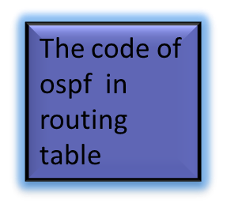
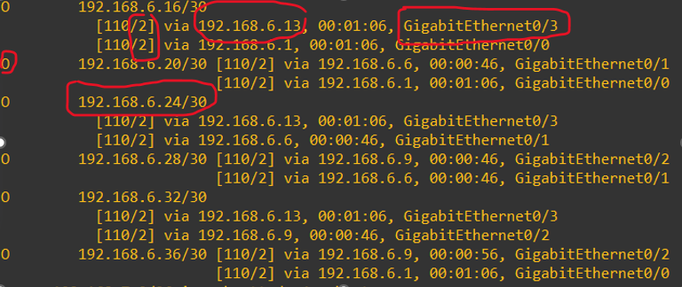
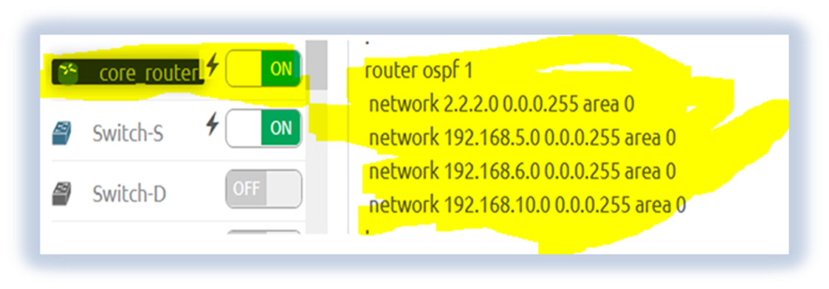
OSPF in routing table

Slide 29
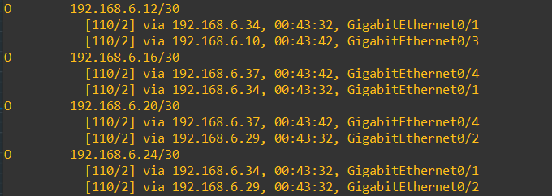
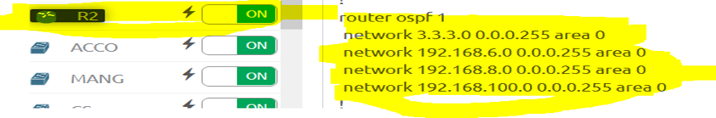
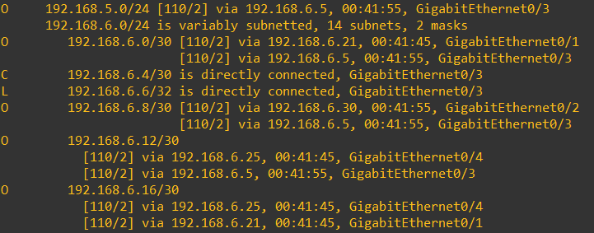
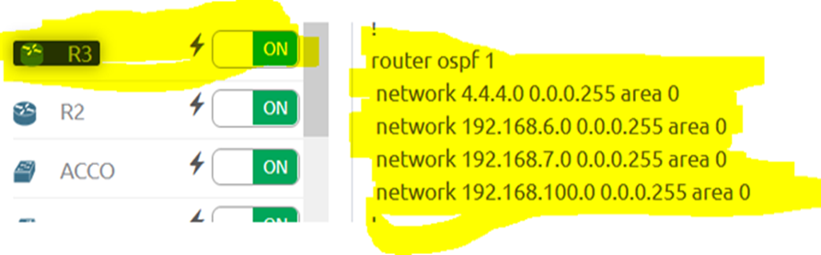
R2 routing table
R3 routing table

Slide 30
Network Device Planes
Data plane
Control plane
Management plane

Slide 31
Control plane security controls
It is divided into
three mitigation techniques:
Control plane security controls
Infrastructure ACLs
Control plane policing
Control plane protection

Slide 32
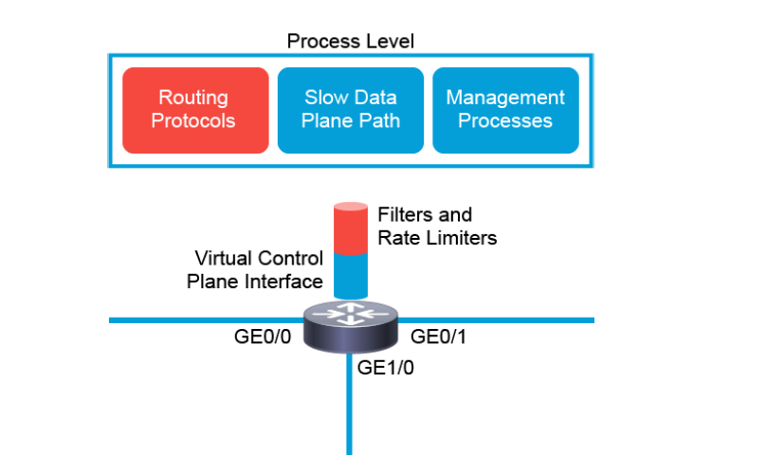
Control plane policing
countermeasure that guards against control plane targeting threats is CoPP
Control Plane Policing (CoPP) is the mechanism that allows us to policy the coming traffic to the Control Plane.

Slide 33
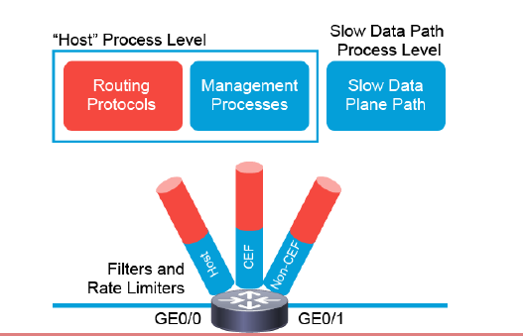
Control plane protection
CPPr extends the CoPP functionality by automatically classifying all CPU bound traffic into three queues (or subinterfaces) under the aggregate control plane interface.
Each subinterface receives and processes a specific type of CPU bound traffic, and each subinterface has a separate traffic policy that is attached to it, which makes the limit configuration easier.

Slide 34
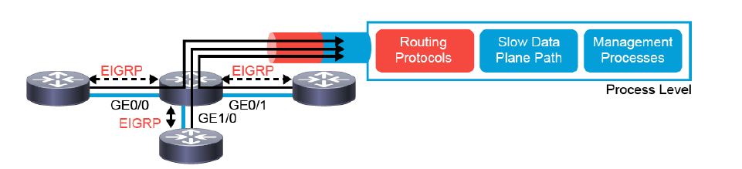
Control plane protection
To configure CPPr, complete the following tasks:
Create traffic classes that describe valid control plane traffic.
Create a traffic policy that will permit, deny, or rate limit the configured traffic classes.
Apply the configured traffic policy to a required CPPr subinterface.

Slide 35
Configuration of Copp and CPPr
#ip access-list extended CPPR-OSPF
Creating an access list with type extended
#class-map CPPR-OSPF-CLASS
Enables class map global configuration command mode used to create a traffic class.
Specifies the match criteria for the class-map.
#match access-group name CPPR-OSPF
Enters policy map configuration mode to define a policy..
#class CPPR-OSPF-CLASS
#control-plane host
#service-policy input control-plane-policy
#police rate 200 pps conform-action transmit exceed-action drop
#policy-map CPPR-POLICY
Enters class map configuration mode, which is used to associate a service policy with a class.
To configure traffic policing, use the police command in policy-map class configuration mode or policy-map class police configuration mode.
applies policies to host control-plane traffic
Applies the specified service policy to packets received on the control-plane.
#permit ospf 192.168.6.0 0.0.0.255
Ospf traffic from 192.168.6.0
To configure traffic policing, use the police command in policy-map class configuration mode or policy-map class police configuration mode
#police rate 50 pps conform-action transmit exceed-action drop
To configure the default traffic rate for other networks
#class class-default

Slide 36
ACL

Slide 37
Access control lists are used for controlling permissions to a computer system or computer network. They are used to filter traffic in and out of a specific device. Those devices can be network devices.
Only one ACL per interface, per direction is allowed.
ACLs are processed top-down; the most specific statements must go at the top of the list. Once a packet meets the ACL criteria, the ACL processing stops and the packet is either permitted or denied.
ACLs are created globally and then applied to interfaces.
An ACL in network configuration can filter traffic going through the router, or traffic to and from the router.

Slide 38
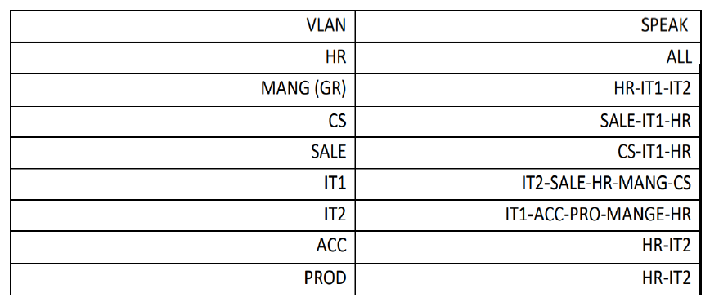
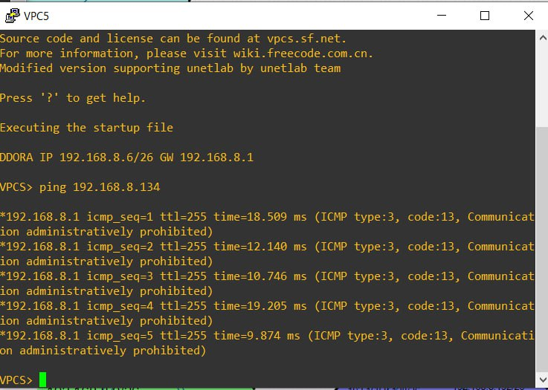
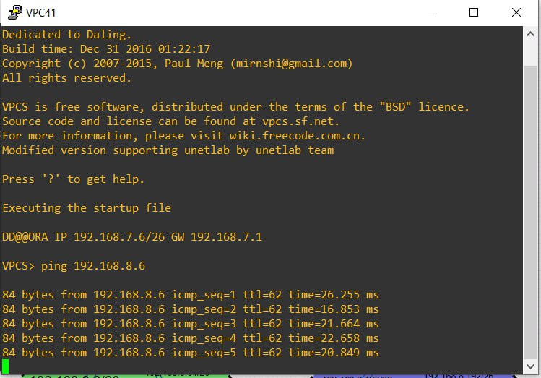
Allowed access :
Examples :
Ping from IT1 to ACC Ping from HR to IT1

Slide 39
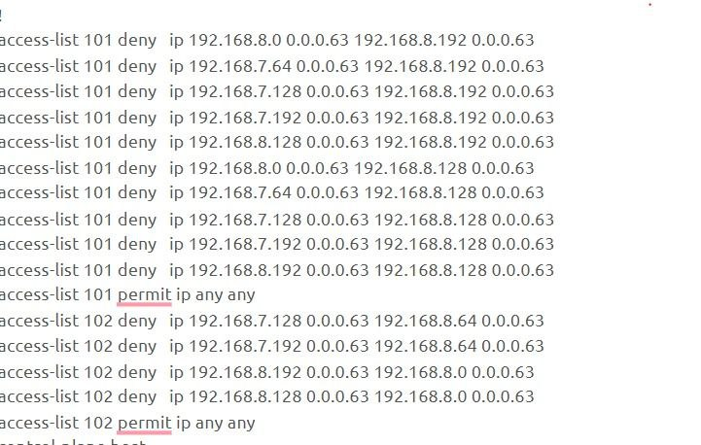
Proposed network configuration

Slide 40
DHCP

Slide 41
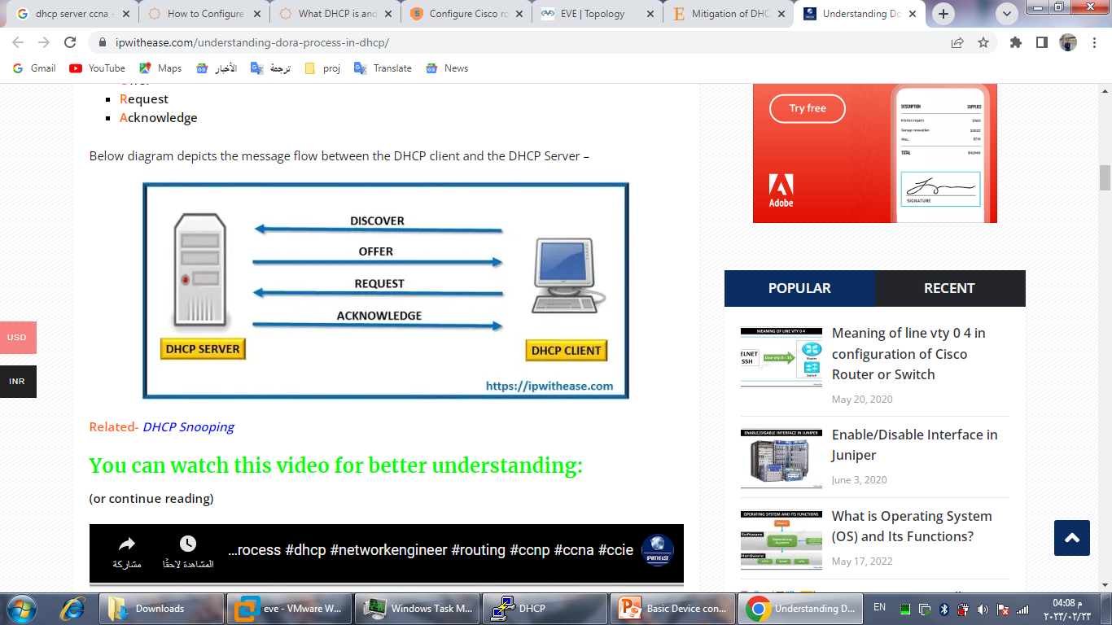
Each device in an IP network requires a valid IP configuration. If the network size is small, an administrator can manually provide an IP configuration to each device. But if the network size is large, assigning and managing the IP configuration on each device can be a challenging task.
Dynamic Host Configuration Protocol (DHCP) is an application layer (first layer) protocol used to distribute various network configuration parameters to devices IP addresses, subnet masks, default gateways, DNS servers, etc.
DHCP employs a client-server architecture; a DHCP client is configured to request network parameters from a DHCP server on the network. (DORA)
A DHCP server is configured with a pool of available IP
addresses and assigns one of them to the DHCP client.

Slide 42
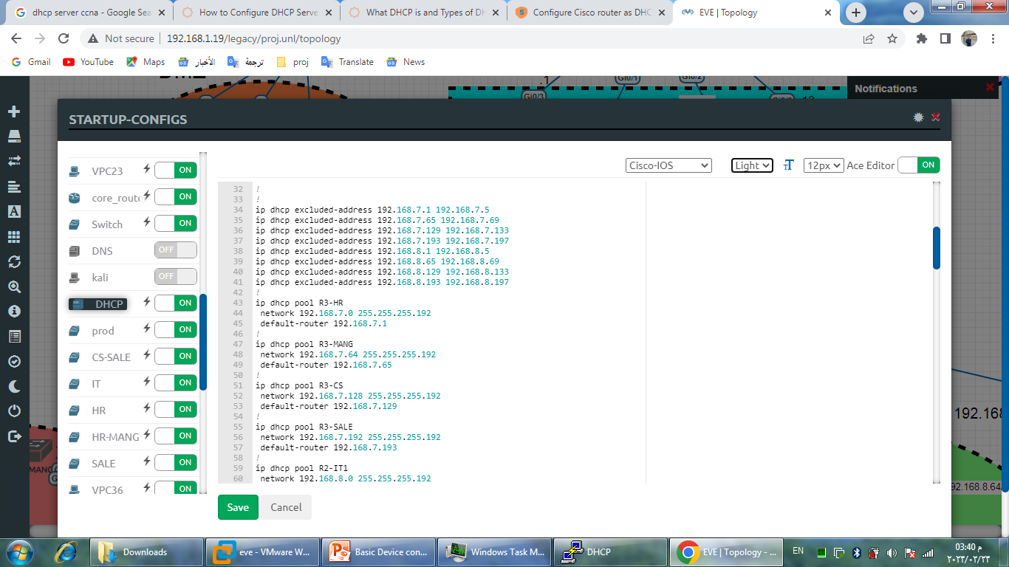
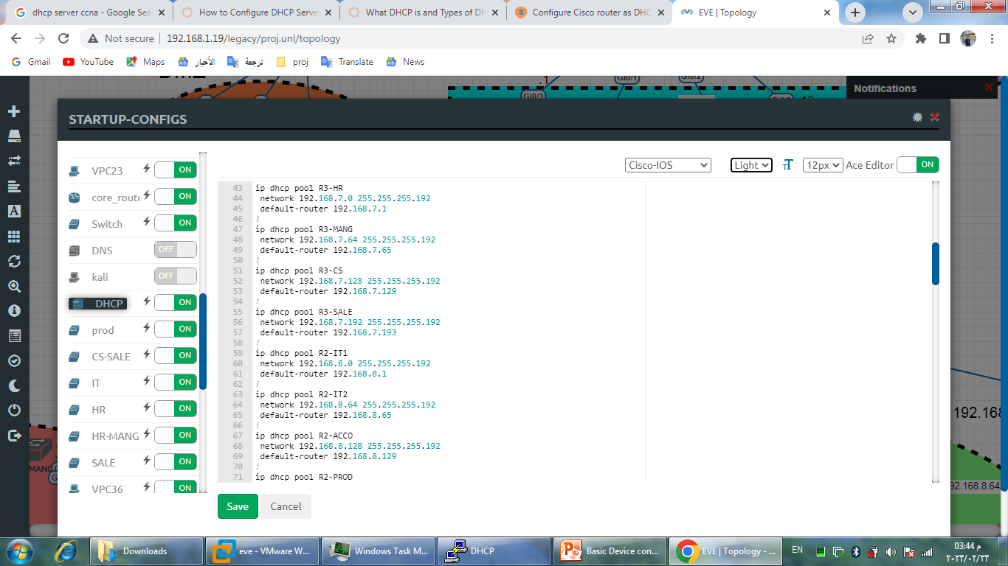
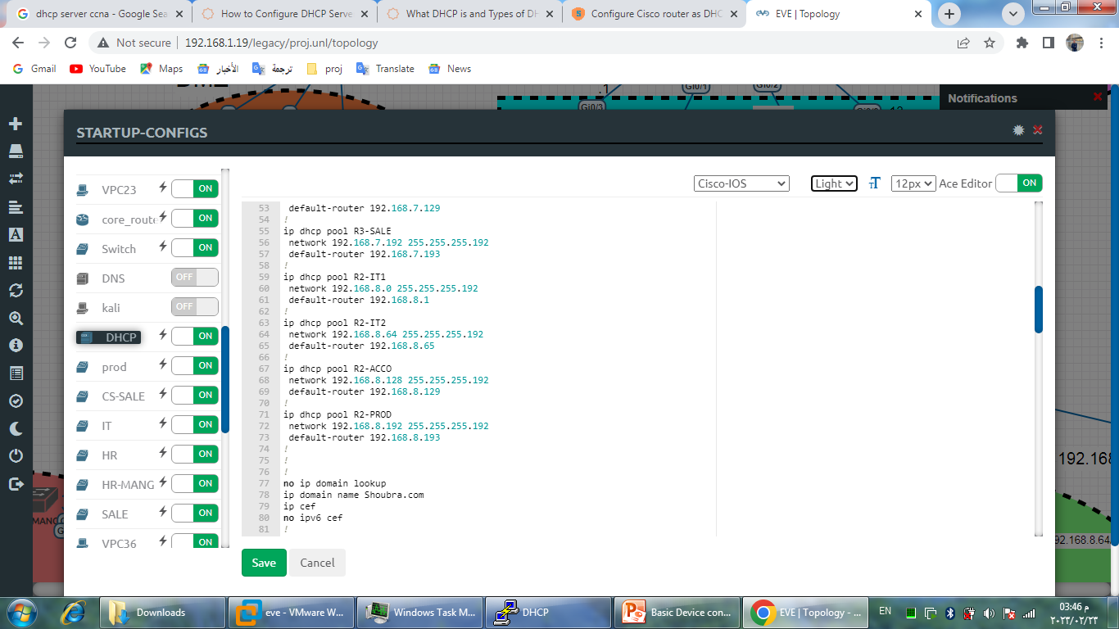
Proposed network configuration
Excluded addresses:
Pools:

Slide 43
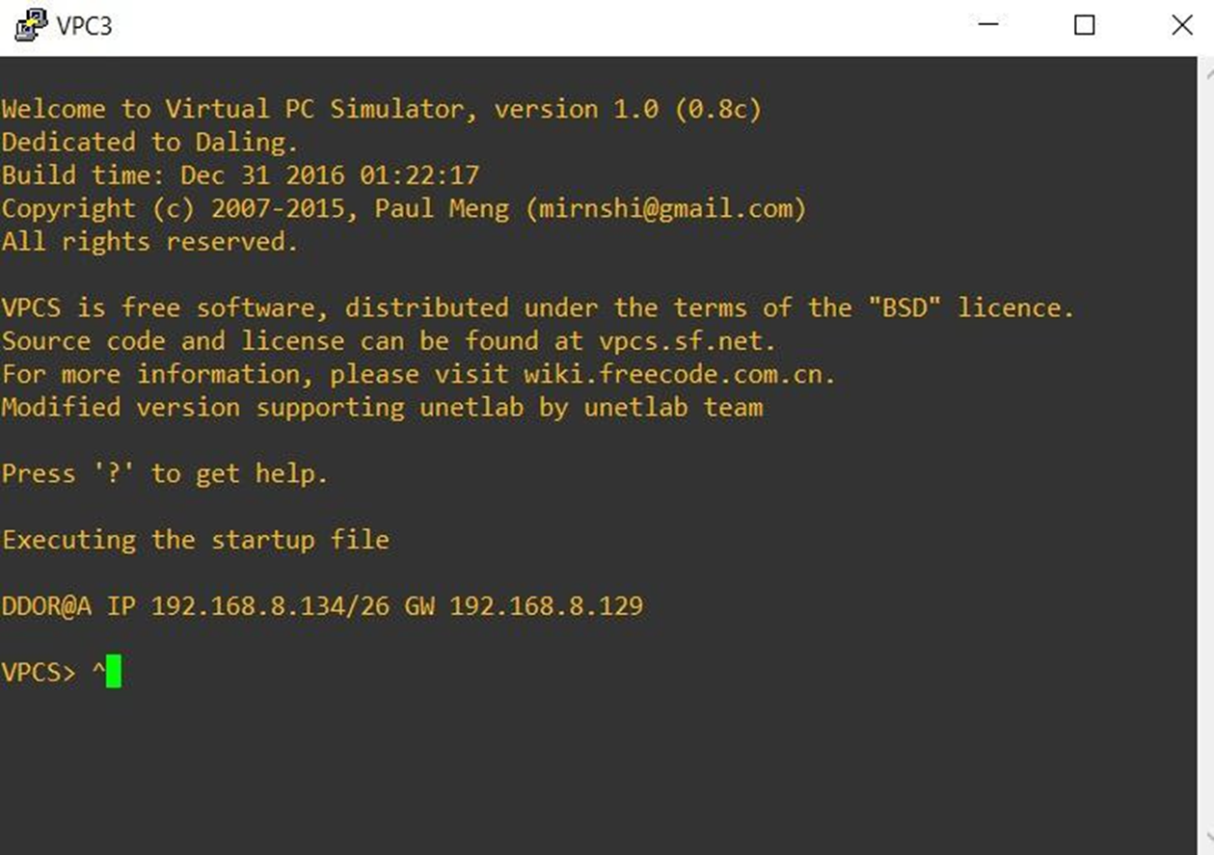
Proposed network configuration

Slide 44
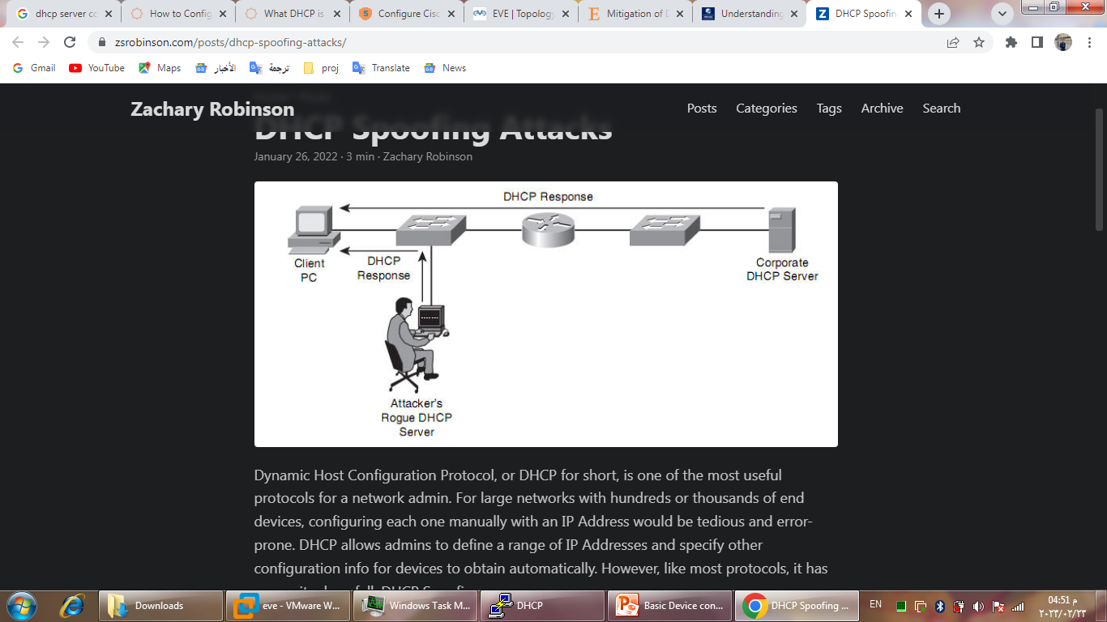
DHCP attacks
DHCP starvation attack : is an attack that targets DHCP servers whereby forged DHCP requests are crafted by an attacker with the intent of exhausting all available IP addresses that can be allocated by the DHCP server. Under this attack, legitimate network users can be denied service
DHCP Spoofing Attack : is when a malicious actor sets up an alternate DHCP server on a network to provide false addressing and configuration information to clients.

Slide 45
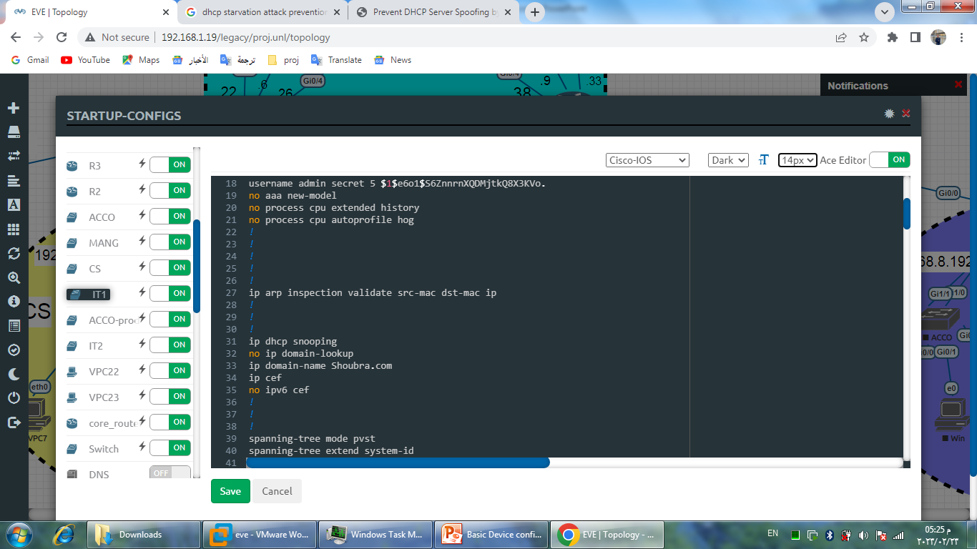
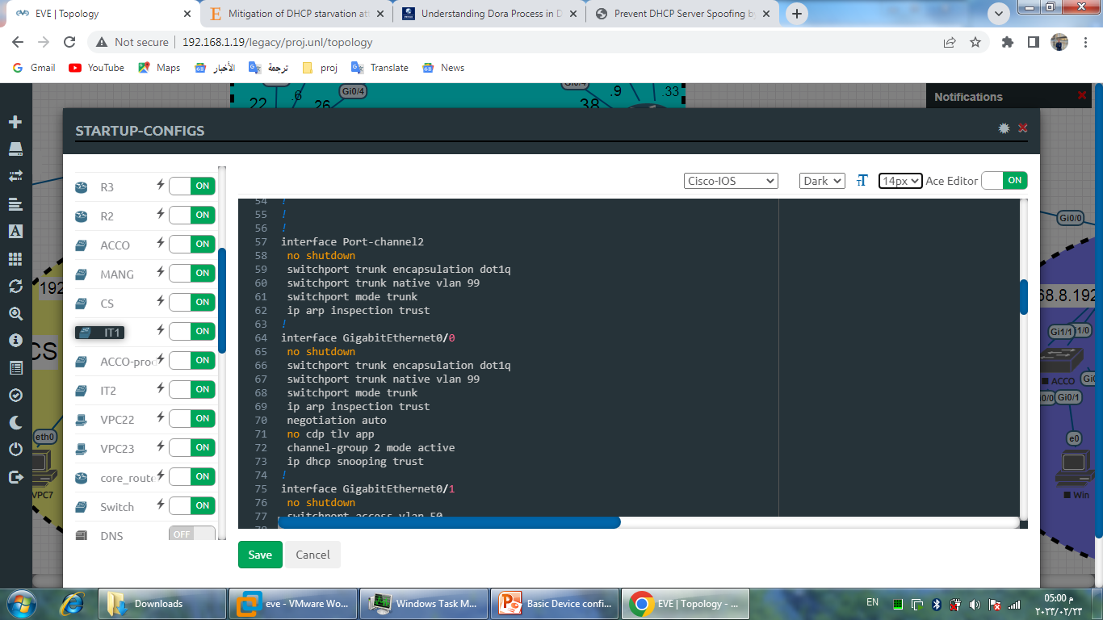
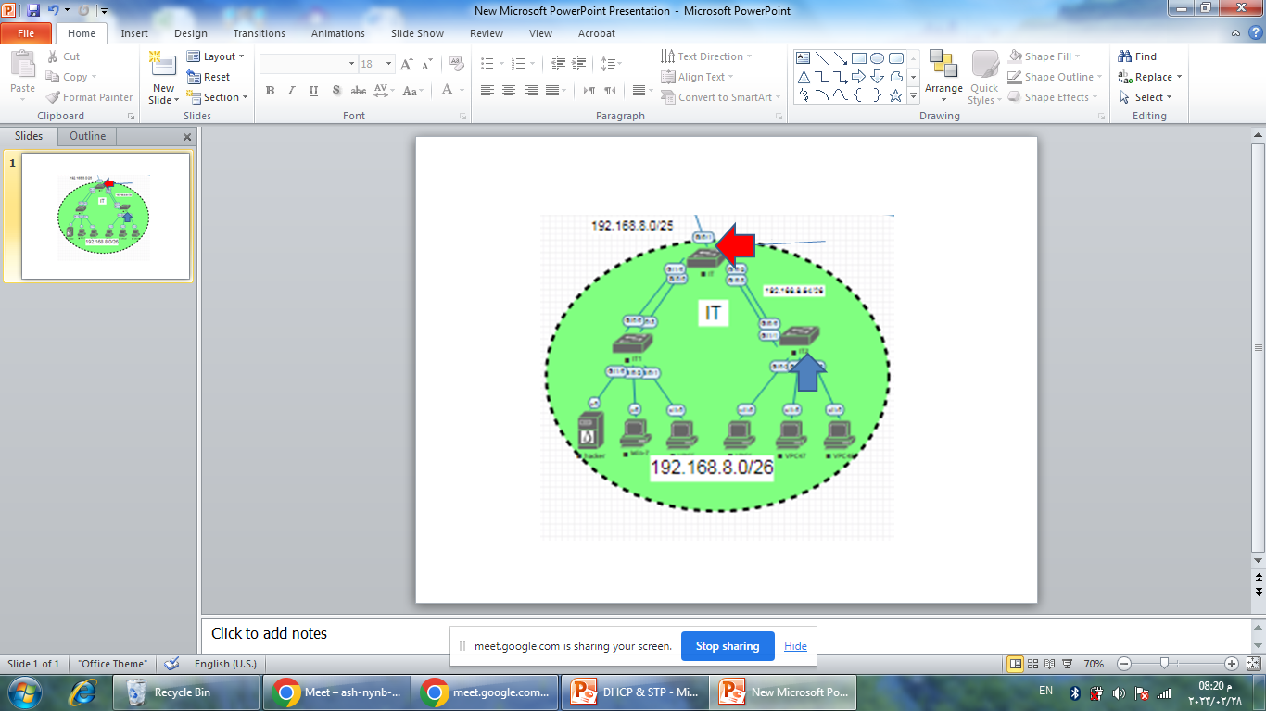
DHCP attacks protection
DHCP starvation attack : One way to prevent a DHCP starvation attack on a network is through port security. Port security is a layer 2 traffic control feature on switches. Switches learn MAC addresses when a frame is forwarded through a switch. By using port security, a limit of the number of source MAC addresses that a port can allow can be set
DHCP Spoofing Attack : The DHCP snooping feature can be used to mitigate a DHCP server spoofing attack. With this mechanism switch ports are configured in two different state, the trusted and untrusted state. If a port is configured to be trusted, it can receive DHCP responses. In other way, if a port is untrusted, it is not allowed to receive DHCP responses, and if a false attackers DHCP response attempts to enter an untrusted port, the port will be disabled

Slide 46
STP

Slide 47
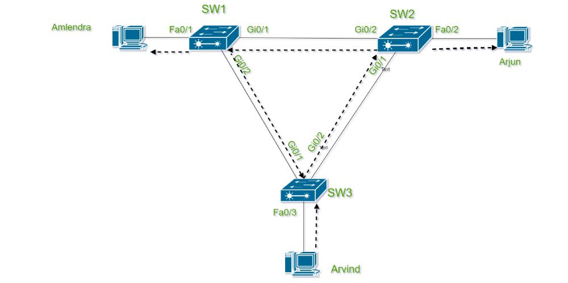
Spanning Tree Protocol (STP) is a Layer 2 protocol that runs on bridges and switches.
The main purpose of STP is to ensure that you do not create loops when you have redundant paths in your network. Loops are deadly to a network.
Spanning trees use an algorithm to search for the redundant links in the LAN and select the best paths. It is mainly used to put all links in either forwarding or blocking.
After this process, all the links without a redundant link is likely to be in the forwarding state. The redundant links that were not as good as the selected links would be blocking. Spanning Tree never uses multiple links to the same destination.
There is no load-sharing feature with Spanning Tree.

Slide 48
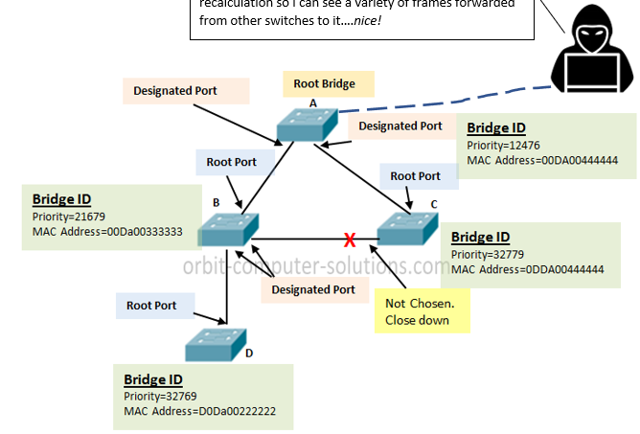
Attacking STP
An attacker can exploit STP to attack a network. One of the hacking techniques is to implement a rogue switch at trunk ports, and manipulate the spanning tree priority by configuring this rogue switch and giving it the lowest ID to become a root bridge. As a consequence, all the traffic will be transferred through this switch and then it will sniff all the traffic or redirect the traffic. To defend against STP attacks, you need to enable the root guard on all switch ports that you don't designate as root ports
2. BPDU attack is when an attacker attacks a device with edge ports and received by them, the device will automatically change the edge ports to non-edge ports and recalculate the spanning tree. If the bridge priority in the BPDUs sent by an attacker is higher than the priority of the root bridge, the network topology will change, thereby interrupting service traffic. To defend against BPDU attack BPDU protection is enabled on a switch, if an edge port on the switch receives a BPDU, the switch will shut down the edge port

Slide 49


Proposed network configuration
General on switches :
PortFast enables the switch to instantaneously transition from blocking state to forwarding state immediately, it is recommended on edge ports, because these ports typically do not send nor receive BPDU.
On ports for protection :
In proposed network STP is not used as there is no redundant paths but we added it for future if we added any redundant path

Slide 50
VLAN

Slide 51

VLAN
The VLANs are one of those networking features that are most commonly used in the networks today.
We need to divide a main LAN into SUBLANS(VLANS) to reduce congestion the result of using more broadcast in the same topology that lead to more flood and slowness at respond process , And if we have more than 20 device in the same network that cause plunge , so we need here to distribute the devices to VLANS to minimize the load at topology.
When we use VLAN it’s prefer to stopping STP to be faster and save 30 seconds which this protocol is take when be on.

Slide 52

In proposed topology we divide it into some branches as shown and each branch use different VLAN such as: HR take VLAN 10 and MANG 20 and so on.
And management VLAN here take 99 and int’s used to establish an IP connection to the switch from a workstation connected to a port in the VLAN.

Slide 53
configurations
VLAN configuration
If the interface connect between device and switch use
(config)#vlan 20
(config)#name (vlan 20)
(config)#int range gig 0/0-3
(config-if)#switchport mode access
(config-if)#switchport mode access VLAN 20
If the interface connect between switch and switch or router
(config)#int gig 0/1
(config-if)#switchport trunk encapsulation dot 1 q
Switchport mode trunk

Slide 54
Configurations(cont.)
Ip for management VLAN
(config)#int vlan 99
(config-if)#no shutdown
(config-if)#ip address(ip) and (subnet mask)
Ip for default gateway
(config)#ip default-gateway (ip)

Slide 55


Link Aggregation
We need to link aggregation to increase the used bandwidth between connections and more secure at failure connection it let you combine multiple ethernet links into a single logical link .
As shown here at our proposed network and the drawing illustration how can LACP be between devices so as we said we can increase speed and can do load balancing .
And more we increase number of connections more be faster and flexible

Slide 56
configuration
(config)#int range gig 0/0-3
(config-if)#channel-group one mode active
(config-if)#int port-channel 1
(config-if)#switchport trunk encapsulation dot1q
(config-if)#switchport mode trunk
(config-if)#switchport trunk native vlan 99
And we must do the same commands at return switch and it must be the same channel group.

Slide 57
LAN Security
At first all unused interfaces in switches it must be shut down for security and that done by
(config)#int range gig 0/0-3
(config-if)#shutdown
MAC flooding attack.
MAC Flooding is a cyber-attack in which an attacker floods network switches with fake MAC addresses to compromise their security. A switch does not broadcast network packets to the whole network and maintains network integrity by segregating data and making use of VLANs.
The motive behind MAC Flooding attack is to steal data from a victim’s system that is being transferred into a network.
MAC spoofing attack
MAC address spoofing attack is where the impostor or hacker hunts the network for valid and original MAC addresses and circumvents access control measures, giving the hacker the advantage to pose as one of the valid MAC addresses.

Slide 58
Mitigation
Port Security .
Due to these functionalities provided by the port security feature, it can be used for protection against:
MAC spoofing
MAC flooding Layer 2 attacks
(config)# interface FastEthernet 0/1
(config-if)# switchport mode access
(config-if)#switchport port-security
(config-if)# switchport port-security maximum 2
(config-if)# switchport port-security violation shutdown
(config-if)# switchport port-security mac-address sticky
To view port security settings for the switch
Switch#show port-security

Slide 59

ARP Spoofing
ARP spoofing attack , also known as and routers that are connected to your Layer ARP cache poisoning 2 network. target hosts, switches, This targeting is achieved by poisoning the ARP caches of systems that are connected to the subnet and by intercepting traffic that is intended for other hosts on the subnet.

Slide 60
Mitigation
At first the DHCP snooping must done
(config)# interface FastEthernet 0/2
(config-if) # ip dhcp snooping trust
(config)#int range gig 0/0-3
(config-if-range)#ip arp inspection limit rate 50
(config-if-range)#ip arp inspection

Slide 61

Syslog
The syslog (system logging) protocol is used for monitoring network devices and sending log messages to a logging server (a syslog server).
The syslog server and syslog protocol work together to facilitate log tracking and management.

Slide 62
What Is a Syslog Server Used For?
A syslog server's primary purpose is to collect log messages from the connected network devices and store them in a centralized location for monitoring purposes. The server keeps the logs in a consistent format, allowing users to spot performance irregularities easily.
Use a syslog server to improve network monitoring and management by inspecting network specifics and parameters. Automate actions by setting up automatic alerts about a variation in a device's data log. Some syslog servers come with a message severity level indicator.
The benefits of using a syslog server and logging data are:
Reduced number of alerts.
Reduced downtime.
Fewer business interruptions.
Preventive troubleshooting.
Finally, syslog servers can store event logs for a long time, enabling access to historical events. Various syslog servers rotate logs and create new files periodically, thus keeping the data organized.

Slide 63



Slide 64

Firewall

Slide 66
Firewall
types
Management NGFW
Registration
Connect to internet
Layer of defenses
ASA
FMC
Device management
Static Routing
Prefilter
NGFW
FDM
Add device
NAT
Security intelligent
Deployment
ACP
IPS
File policy
ACP

Slide 67
Firewall types
Cisco Firepower NGFW
Traditional firewall
ASA firewall
All the ASA feature + IPS( intrusion prevention system )
provides a top-notch performance whereas ASA ranks lower in it.
ASA is quite expensive in comparison with Cisco FTD, which is highly affordable.
Cisco FTD consumes less time whereas ASA consumes more as it requires an ample amount of manual work.
Packet Filtering with ACL
Stateful Inspection
Application Inspection
NAT
DHCP Server or Client
Static Routing and dynamic Routing Protocols RIP, EIGRP, OSPF
L3 Firewall or L2 Firewall
VPN Gateway (IPsec and SSL(
Botnet Traffic Filtering

Slide 68
Management of FTD
Cisco Firepower Device Manager (FDM)
Firepower Management Center (FMC),
Local management not support high availability
Management more than one of NGFW
Support high availability

Slide 69



FTD to FMC registration

Slide 70


Connect the inside and outside

Slide 71

FTD layer of defense

Slide 72

Prefilter
Block
Fastpath
Analyze

Slide 73

ACP
Allow
Trust
Block
block with reset
Interactive block and block with reset
Monitor

Slide 74

Layer defense (cont.)
Security intelligent: Security intelligence works by matching traffic against a whitelist and a blacklist and blocking traffic to or from IP addresses, URLs, or DNS that are on the blacklist.
IPS policy: uses intrusion rules (also known as Snort rules) to examine packets for threats.
File and malware policy: allows to detect and block certain filetypes or examine files for malware.
Discovery Policies : collect information from user

Slide 75

ACP

Slide 76

ACP (cont.)
Rule 1 for zone

Slide 77

ACP (cont.)
Rule 1 for network

Slide 78


ACP
Network object
Network group

Slide 79
Servers

Slide 80
overview
A server is a computer program or a device that provides functionality for called clients which are other programs or devices. This architecture is called the client–server model.
Servers can provide various functionalities called services. These services include sharing data or resources among multiple clients or performing computation for a client. Multiple clients can be served by a single server, and a single client can use multiple servers.

Slide 81
FTP Server

Slide 82
What is FTP (File Transfer Protocol)?
FTP (File Transfer Protocol) is a network protocol for transmitting files between computers over (TCP/IP) connections. Within the TCP/IP suite.
In an FTP transaction, the end user’s computer is typically called the local host. The second computer involved in FTP is a remote host, which is usually a server. Servers must be set up to run FTP services, and the client must have FTP software installed to access these services like “file zilla”.

Slide 83

FTP server in proposed network
In the proposed network we use Linux-ubuntu as an FTP server and its position in the proposed network is next to the DHCP server on the server zone in the inside zone of the firewall.

Slide 84

How does FTP work?
Step 1: The client establishes the first connection to the server for control traffic using TCP port 21.
Step 2: The client establishes the second connection to the server for the actual data transfer using TCP port 20. This connection is created every time there is data to be transferred.
Step 3: The data transfer can happen in either direction. The client can download (pull) data from the server, or the client can upload (push) data to the server.

Slide 85
FTP types
1
2
3
4
Anonymous FTP: This is the most basic form of FTP. It provides support for data transfers without encrypting data or using a username and password. It works on port 21.
Password-protected FTP: This is also a basic FTP service, but it requires the use of a username and password, though the service might not be encrypted or secure. It also works on port 21.
FTP Secure (FTPS): Sometimes referred to as FTP Secure Sockets Layer (FTP- SSL). FTPS was initially used to help enable a more secure form of FTP data transfer. It works on port 990.
FTP over explicit SSL/TLS (FTPES). This approach enables explicit TLS support by upgrading an FTP connection over port 21 to an encrypted connection. This is a commonly used approach by web and file sharing services to enable secure file transfers.

Slide 86
FTP security
By default, FTP does not encrypt traffic, and individuals can capture packets to read usernames, passwords, and other data. By encrypting FTP with FTPS or FTPES, data is protected, limiting the ability of an attacker to eavesdrop on a connection and steal data. FTP may still be vulnerable to brute-force attacks against user/password authentication spoofing, an FTP bounce attack or a distributed denial-of service attack.

Slide 87
FTP clints
1
2
3
4
FileZilla: for Windows, macOS and Linux that supports FTP, FTPS and SFTP.
Transmit: for macOS that supports FTP and SSH.
WinSCP: Windows FTP client that supports FTP, SSH and SFTP.
WS FTP: This is another Windows FTP client that supports SSH.

Slide 88

FTP used in proposed network

Slide 89

WEB Server

Slide 90

In proposed network
In the proposed network we use Linux-tiny core as a Web server and its position in the proposed network is the DMZ zone of the firewall.

Slide 91
What is a web server?
A web server is software and hardware that uses HTTP (Hypertext Transfer Protocol) and other protocols to respond to client requests made over the World Wide Web.
The main job of a web server is to display website content through storing, processing, and delivering webpages to users.
Web server hardware is connected to the internet and allows data to be exchanged with other connected devices, while web server software controls how a user accesses hosted file.

Slide 92
Example of web server uses:
sending and receiving emails.
downloading requests for File Transfer Protocol (FTP) files.
building and publishing webpages.

Slide 93
How do web servers work?
Web server software is accessed through the domain names of websites and ensures the delivery of the site’s content to the requesting user. As hardware, a web server is a computer that stores web server software and other files related to a website, such as HTML documents, CSS, images, and JavaScript files.
When a web browser, like Google Chrome or Firefox, needs a file that is hosted on a web server, the browser will request the file by HTTP. the HTTP server will accept the request, find the content, and send it back to the browser through HTTP.

Slide 94
To better understand how the web browser and web server interact:
Step1:
The browser interprets the three parts of URL:
http (the protocol).
www.cisco.com (the server’s name or Ip of the server).
index.html (the specific filename requested).

Slide 95
Step2:
The browser then checks with a name server to convert www.cisco.com into a numeric IP address.
The client initiates an HTTP request to a server by sending a GET request to the server and asks for the index.html file.
Step3:
In response to the request, the server sends the HTML code for this web page to the browser.
Step4:
The browser deciphers the HTML code and formats the page for the browser window.

Slide 96
In proposed network

Slide 97
Common and top web server software on the market
Apache HTTP Server: Developed by Apache Software Foundation, it is a free and open-source web server for Windows, Mac OS X, Linux.
Microsoft Internet Information Services (IIS): Developed by Microsoft for Microsoft platforms; it is not open sourced, but widely used.
Sun Java System Web Server: A free web server from Sun Microsystems that can run on Windows, Linux, and Unix. It is well-equipped to handle medium to large websites.

Slide 98
Web server security practices:
a reverse proxy, which is designed to hide an internal server and act as an intermediary for traffic originating on an internal server.
keeping web servers patched and up to date to help ensure the web server is not susceptible to vulnerabilities.
access restriction through processes such as limiting the web host’s access to infrastructure machines or using Secure Socket Shell (SSH).
network monitoring to make sure there is not any unauthorized activity.
using a firewall and SSL as firewalls can monitor HTTP traffic while having a Secure Sockets Layer (SSL) can help keep data secure.
The Cisco WSA solution complements the deep packet inspection and stateful filtering capabilities of the firewalls by providing additional web security features.

Slide 99
Future Work

Slide 100
Mail server : A mail server also known as a mail transfer agent is an application that receives incoming email from local users and remote senders and forwards outgoing messages for delivery. A computer dedicated to running these applications is also called a mail server.
VPN: A VPN enables remote users to securely access a private network over the internet. VPNs used for secure remote access or to connect dispersed networks.
AAA server : stands for Authentication, Authorization, and Accounting, which are three key processes in network security.
ESA stands for Email Security Appliance, which is a security device that protects organizations from email-borne threats, such as spam, viruses, and phishing attacks.
WSA stands for Web Security Appliance, which is a security device that protects organizations from web-based threats, such as malware, viruses, and phishing attack.
Network redundancy: Providing alternative paths for traffic to ensure continuous data flow in case of failure. Network uptime is the duration a network stays functional. Higher network uptime means easier, faster, and more reliable network access for customers and employees.

Slide 101
Thanks for attention

